Slide 1

Transition to Electric Vehicles:
Evidence-Informed Interventions
for Eastern European Policy Makers
Simona Lupșa (16421604)
Eva Wehrle (16433718)

Slide 2
Problem & Relevance
Transport ≈ 25% of EU GHG emissions
Transition to EVs cornerstone of EU’s climate strategy
EV uptake is uneven across Europe
Very high in Scandinavia
Low in many Eastern European countries (~10%)
These regions risk being locked into fossil-based mobility
Notes:
Transition: How to we increase EV uptake in Eastern Europe?/ Hungary

Slide 3
Context & Evidence
Eastern Europe:
Low EV adoption
High social media use (important information channel)
Network analysis shows:
Initial EV adoption is decisive
Targeting highly connected individuals is far more effective than random subsidies
Infrastructure has only limited influence on EV uptake

Slide 4
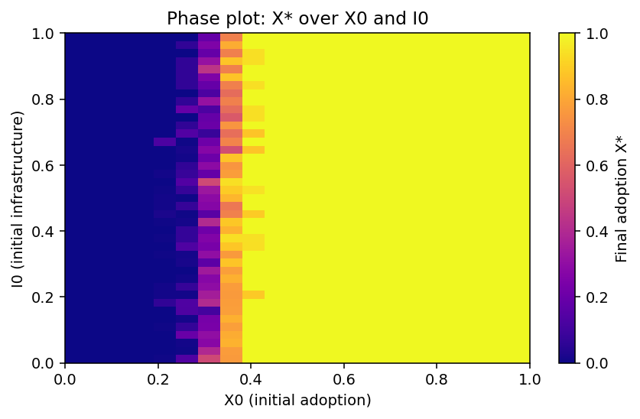
Context & Evidence
Network analysis shows:
Initial adoption is decisive
Infrastructure has only limited influence on EV uptake

Slide 5
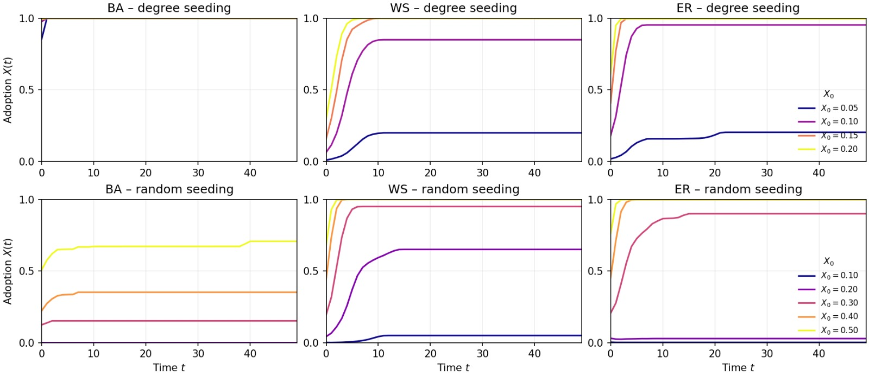
Context & Evidence
Network analysis shows:
Targeting highly connected individuals is far more effective than fat-handed untargeted subsidies

Slide 6
Policy Intervention
Therefore, the intervention should:
Increase early adoption
Target high-reach individuals to trigger imitation cascades
Intervention tested:
Select a small share of high-reach social media influencers
Provide free EVs in exchange for one year of promotion
Choose influencers across different sectors to reach diverse social groups
Combine with temporary purchase subsidies for EVs during the programme year
Silva et al. (2025)

Slide 7
Setup
Baseline: 10% EV adoption (Eastern Europe benchmark)
Policy adds +3% targeted adopters (high-degree nodes)
Influencers receive free EVs
Followers eligible for temporary purchase subsidy -> increases individual payoff/incentive
One-year, early intervention
Silva et al. (2025)

Slide 8
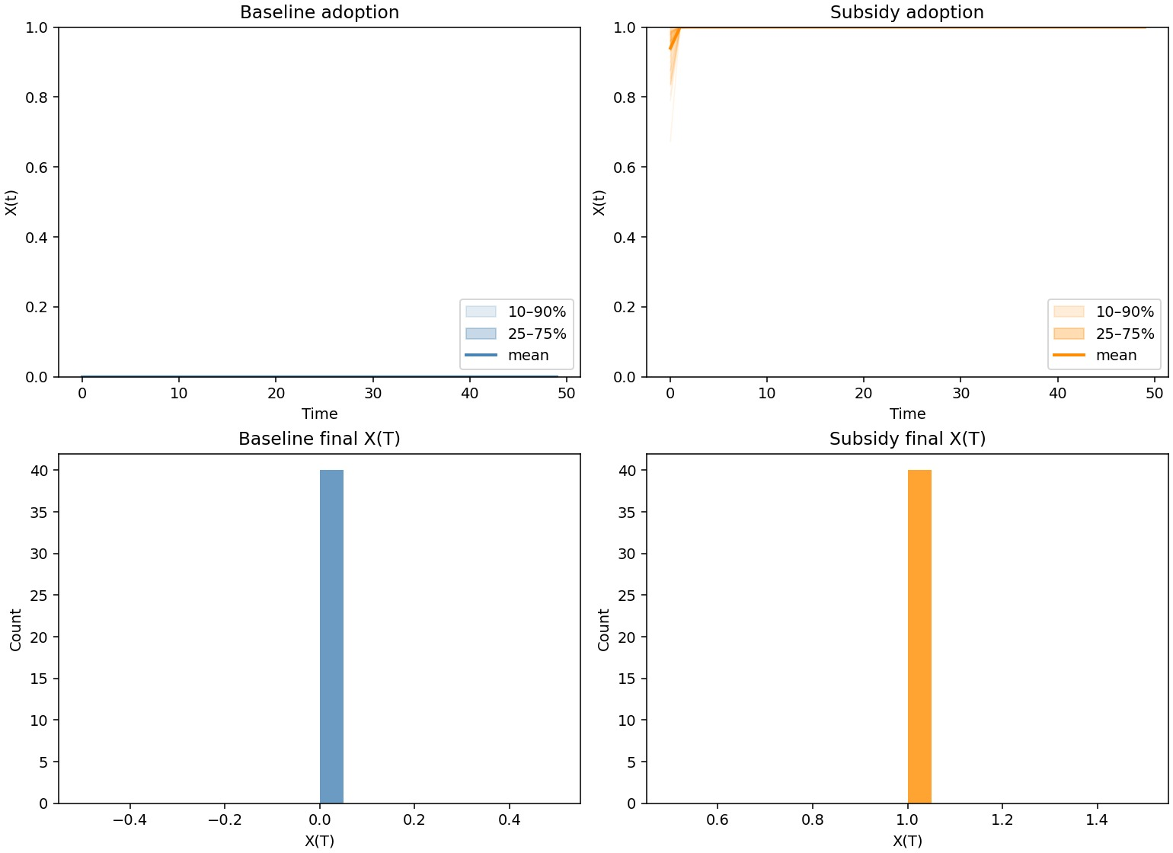
Results: Policy Impact
Rapid take-off to full adoption
Very low variability across runs
Adoption remains high after subsidy ends
Small targeted shock → system-wide tipping
Notes:
Briefly explain why BA network (social media structure)

Slide 9
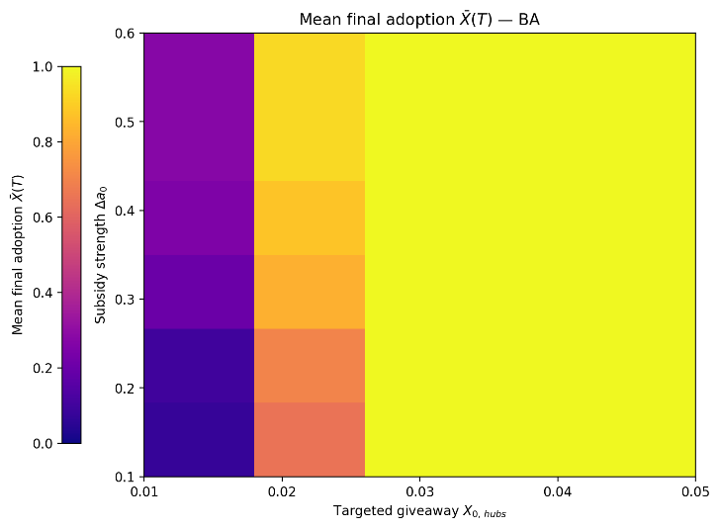
How much Targeting and Subsidy is needed?
2–3% targeted hubs sufficient
Subsidy strength plays secondary role
Sharp tipping threshold
Targeting beats increasing subsidy size

Slide 10
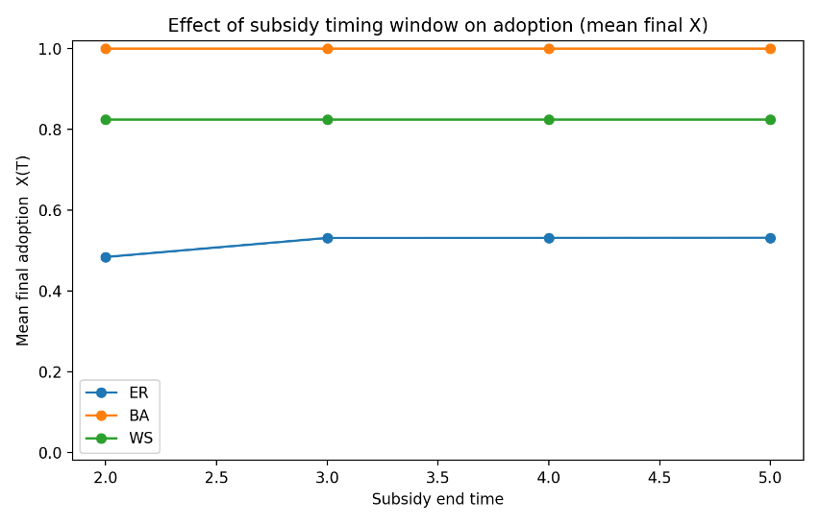
Timing: How Long Does Support Need to Last?
Early intervention is decisive
Short subsidy window sufficient
No reversal after subsidy removal

Slide 11
Policy Recommendations
Prioritise early-stage adoption rather than broad infrastructure spending in low-uptake countries
Replace untargeted subsidies with targeted, high-reach seeding strategies
Use social media hubs as leverage points where networks are scale-free
Apply policies selectively:
suitable for Eastern Europe
not cost-effective in already saturated EV markets

Slide 12
Thank you for your attention!

